Slide 1

WEB 2.0 (CSE 2056)
Department of Computer Science and Engineering
School of Engineering,
PRESIDENCY UNIVERSITY

Slide 2
Module 1 Introduction to Web 2.0 Topics :
Requirements Engineering:
Overview of internet and its evolution
Comparison of web 1.0 andweb 2.0
characteristics of web 2.0
Introduction to server-side scripting-PHP
PHP and MySQL interaction
Web 2.0 technologies
Overview of JavaScript frameworks-AJAX
PHP example, AJAX example

Slide 3
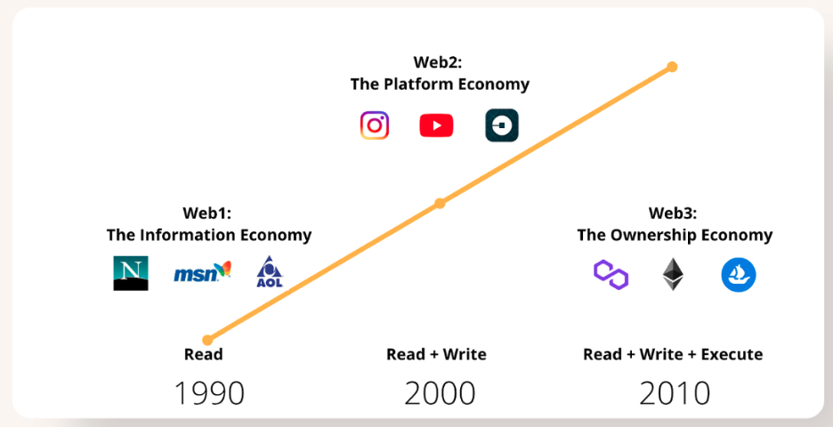
INDEX
Evolution of WEB
The World Wide Web is the key tool used by billions of people to distribute information, read and create it, and connect with others over the internet. The web has evolved considerably over time, and its contemporary uses are almost unrecognizable from its inception. The development of the web is often classified into three stages: Web 1.0, Web 2.0, and Web 3.0.

Slide 4
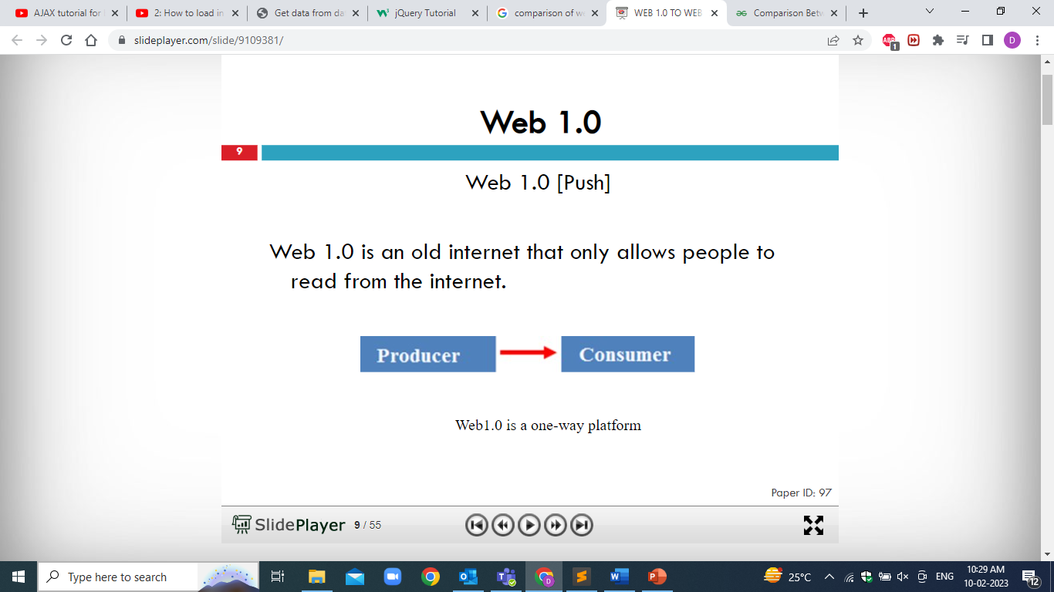

Slide 5
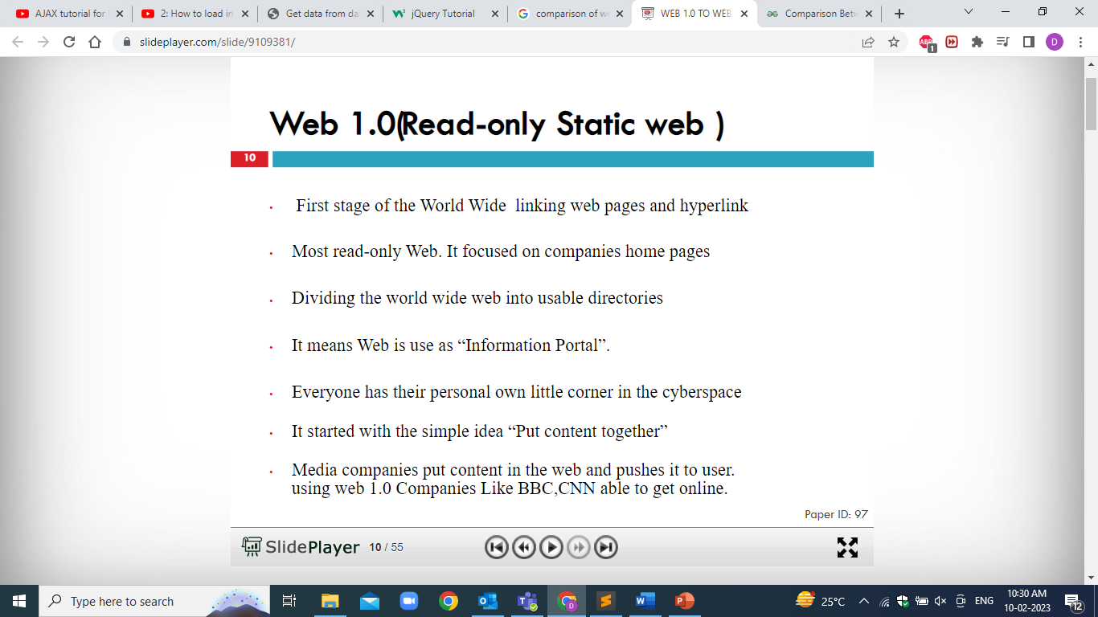

Slide 6
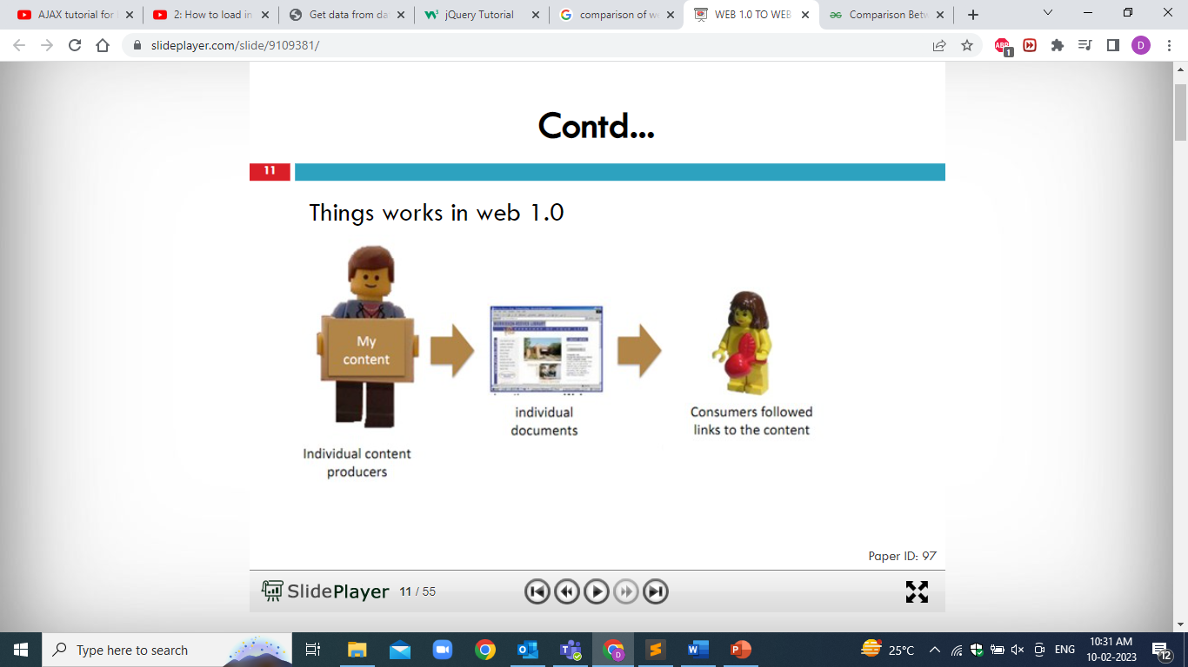

Slide 7
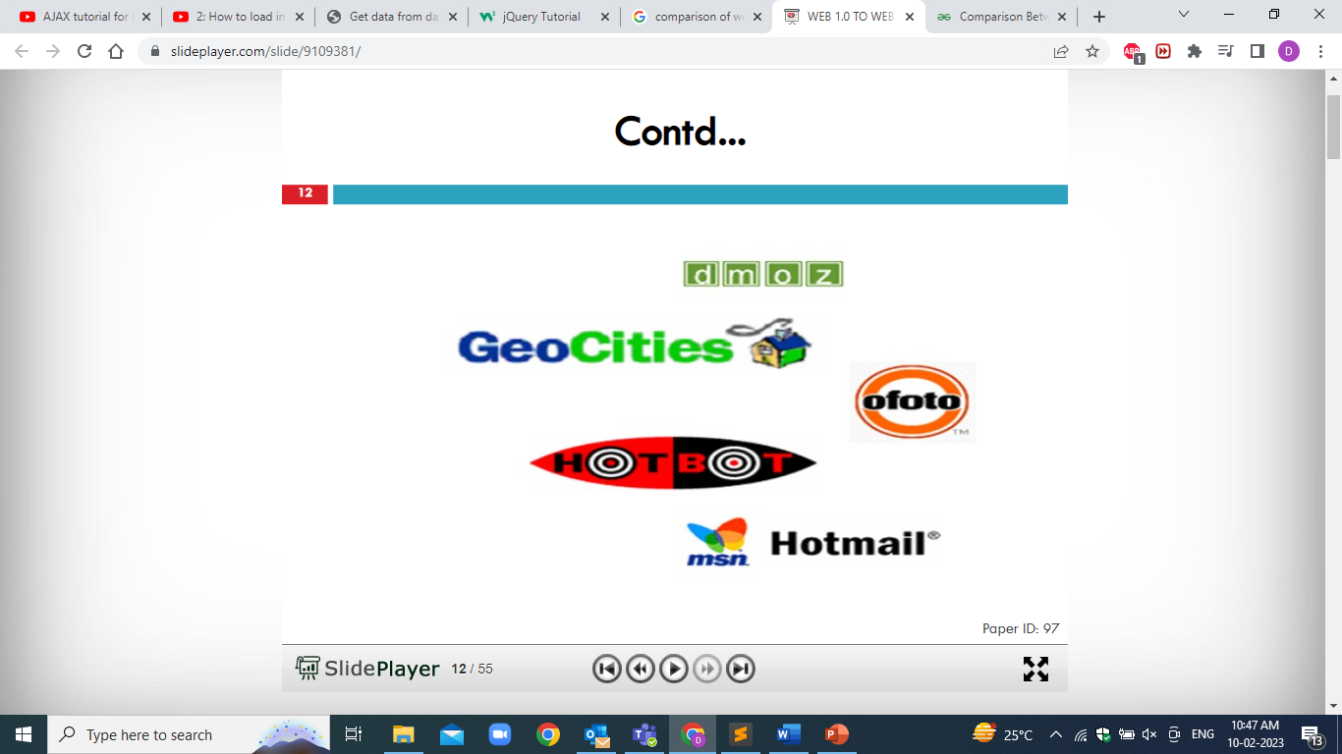

Slide 8
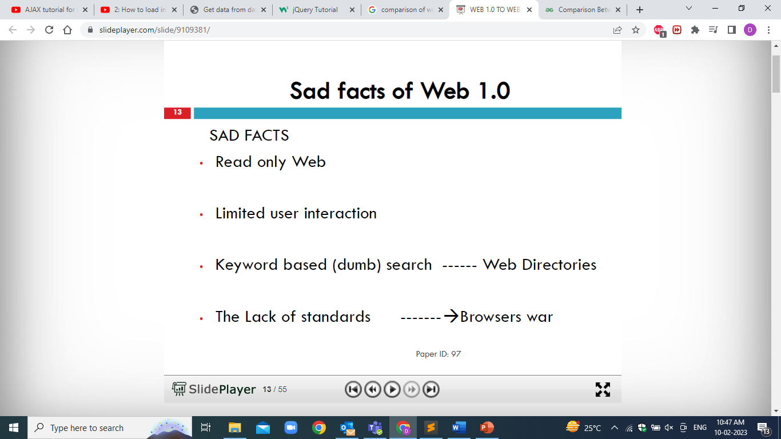

Slide 9
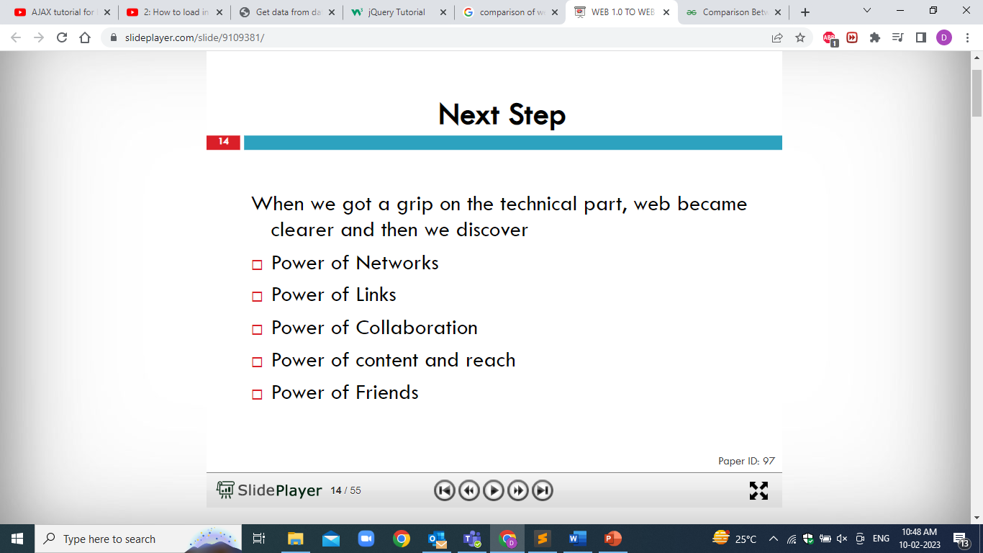

Slide 10
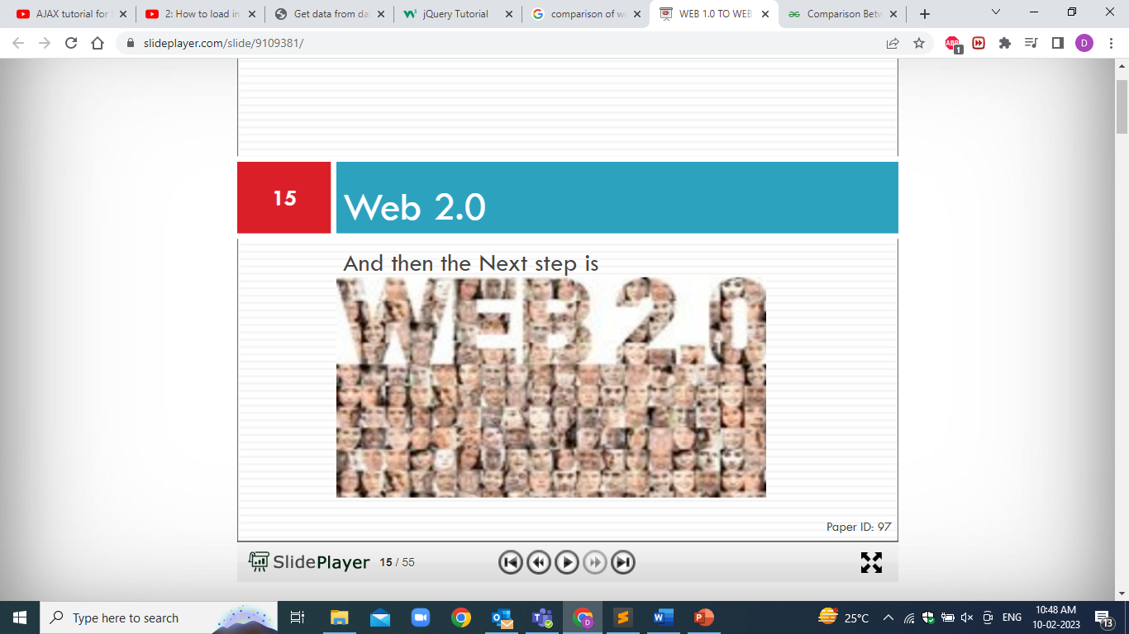

Slide 11
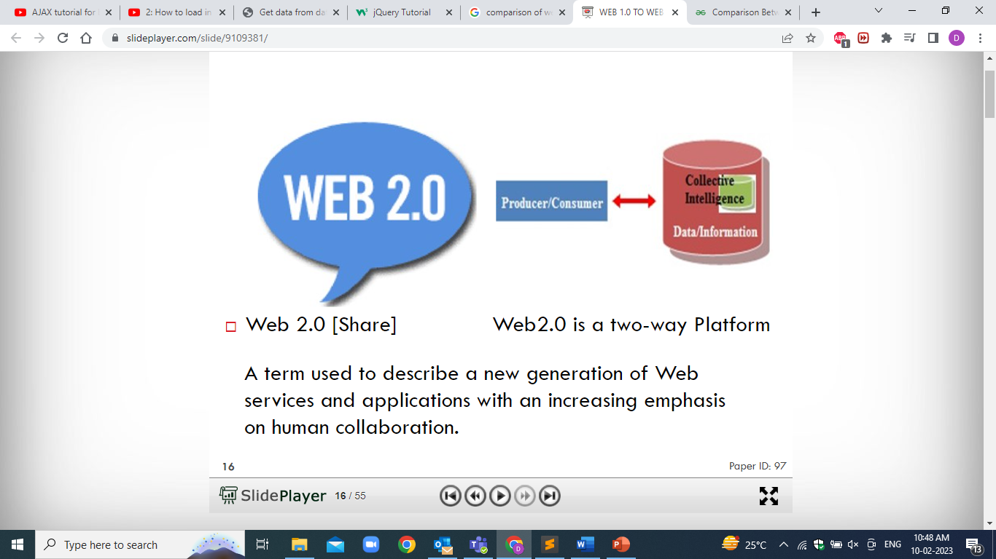

Slide 12
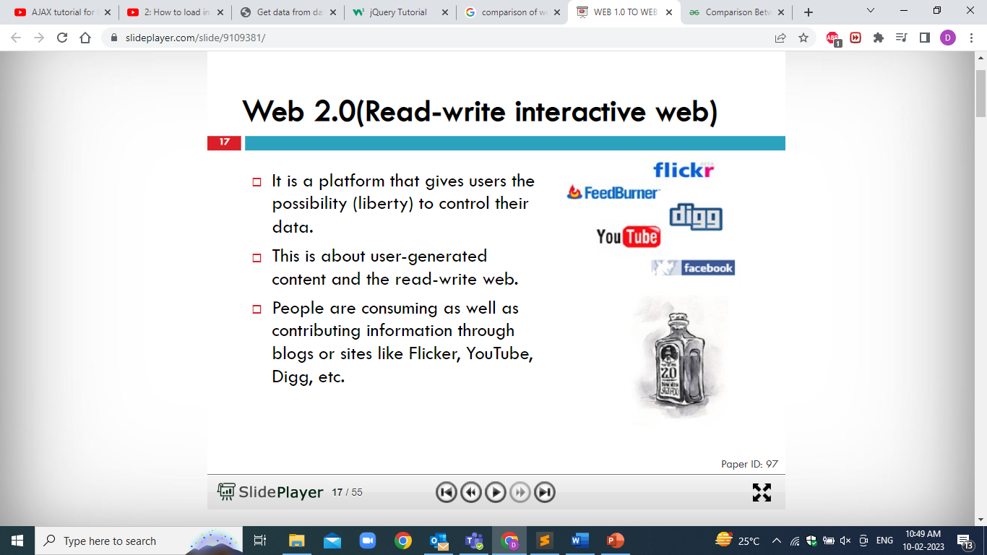

Slide 13
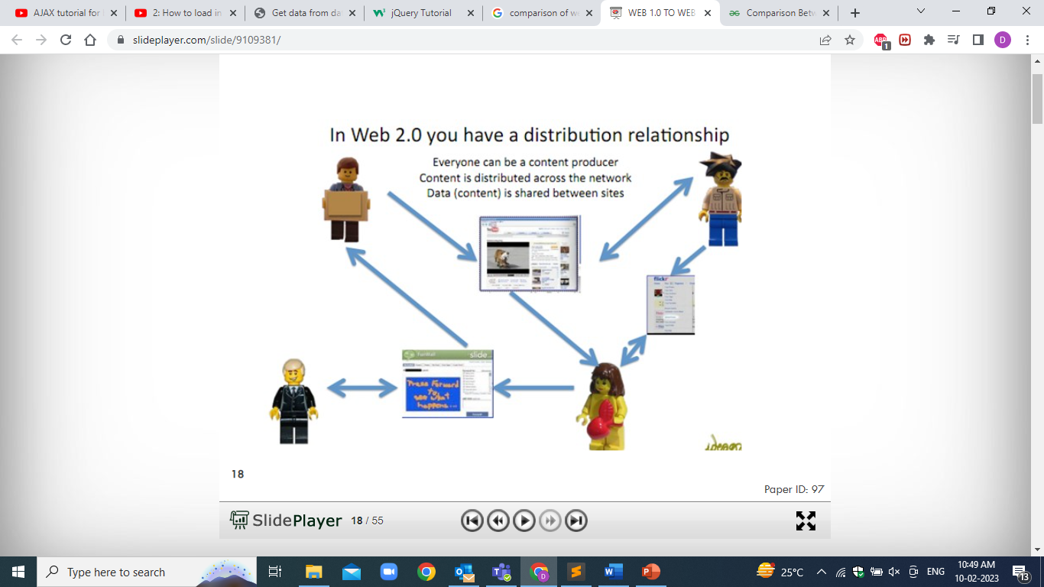

Slide 14
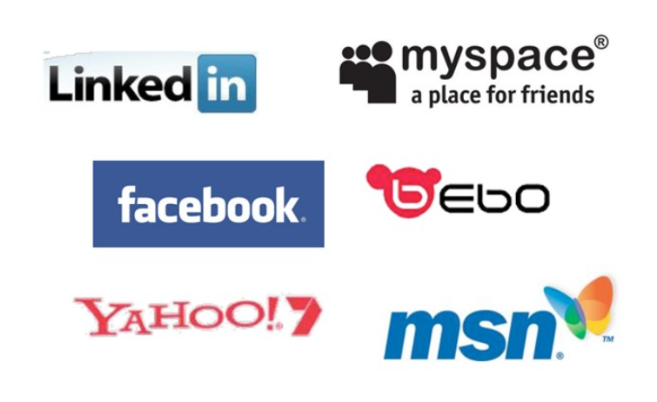

Slide 15


Slide 16
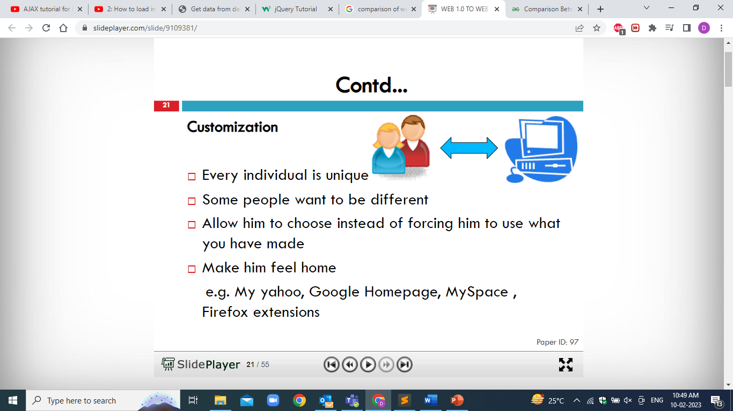

Slide 17
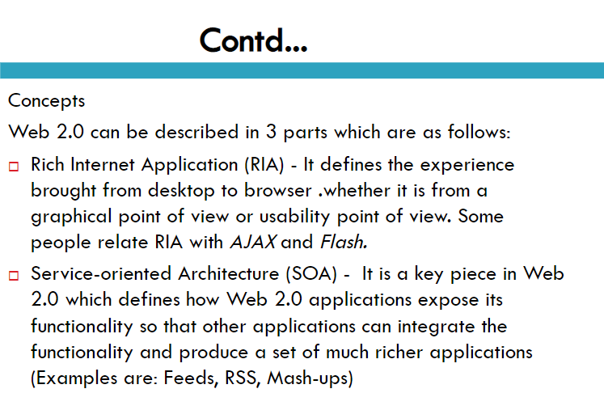

Slide 18
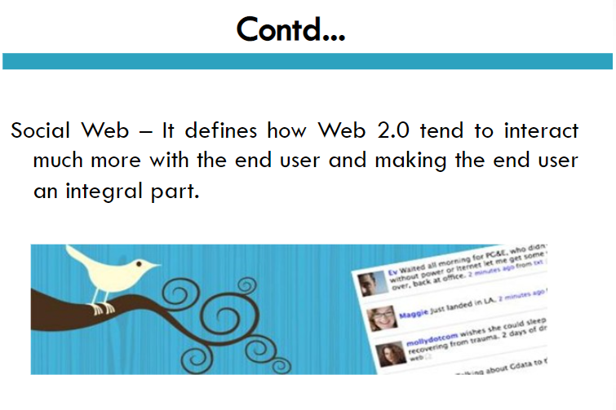

Slide 19
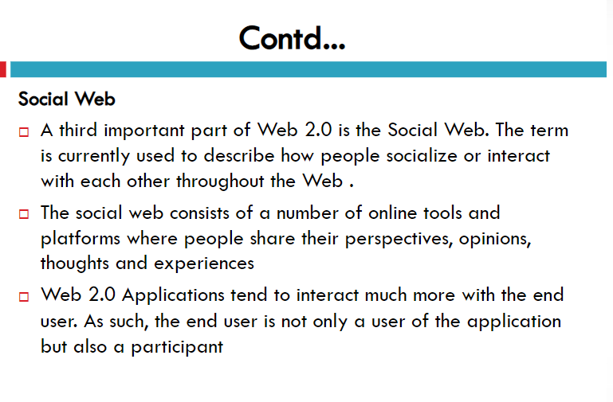

Slide 20
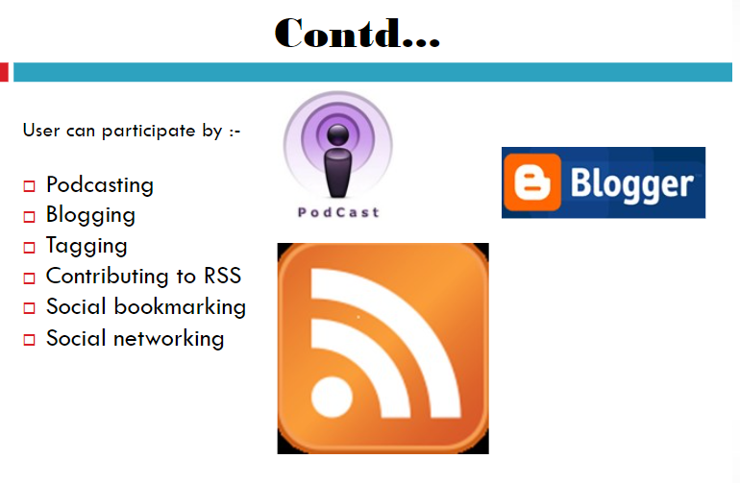

Slide 21
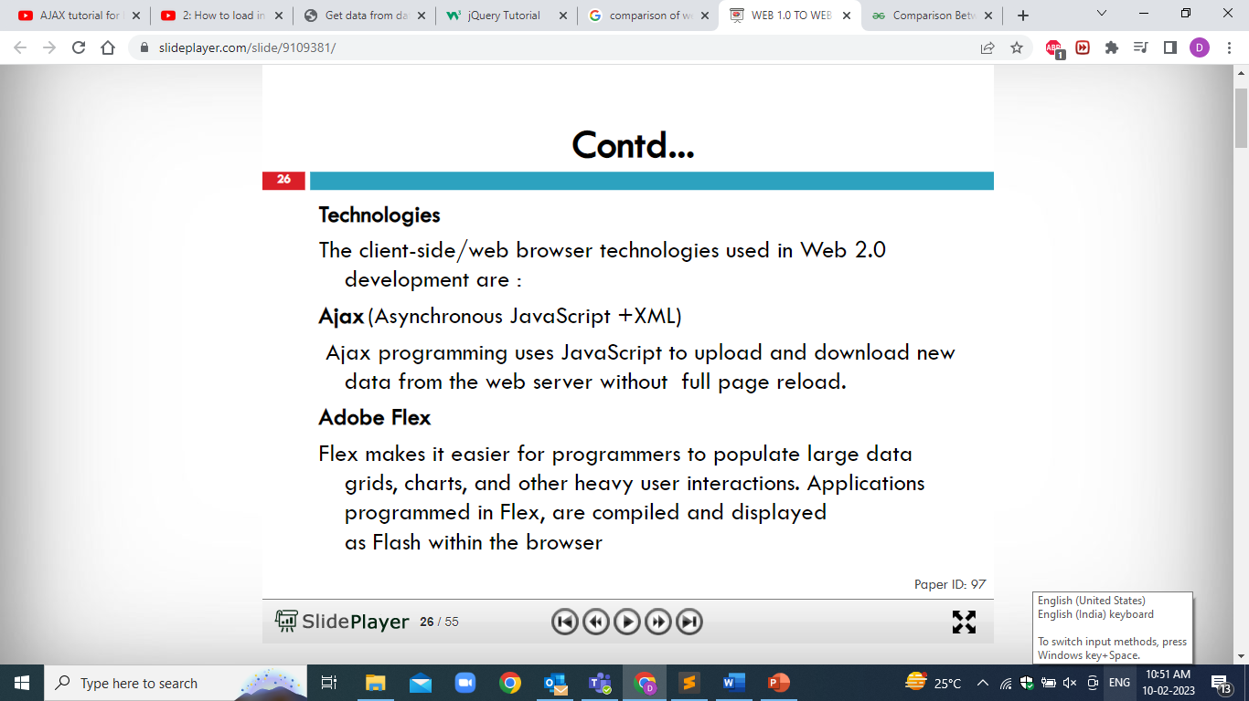

Slide 22
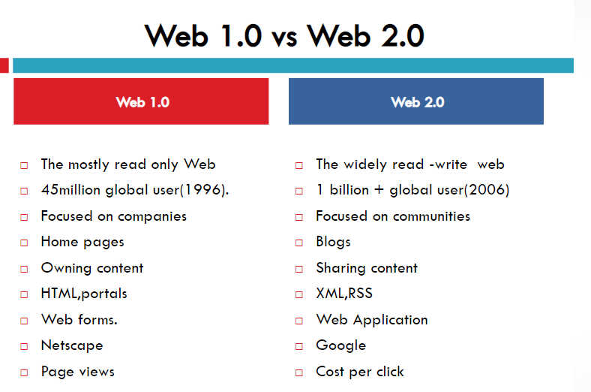

Slide 23
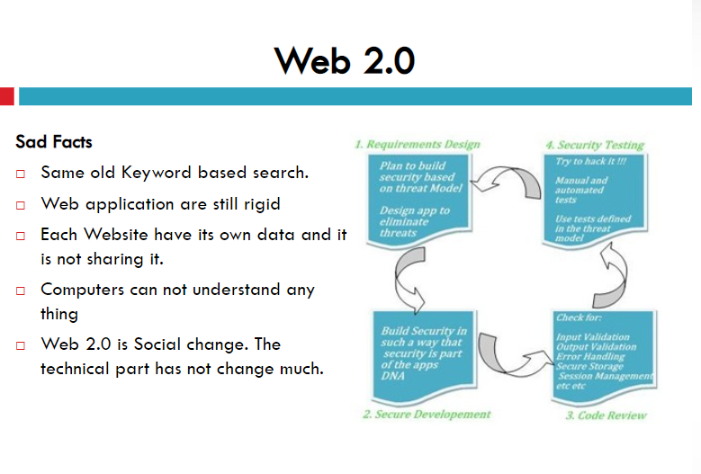

Slide 24
Scripting Language
A new style of programming language different from system programming languages
Designed as glue language or system integration language
A single statement can execute huge number of machine instructions
Scripting languages are interpreted(rather than compiled)
Are normally ‘typeless’
Build complex algorithms and data structures..
Can create dynamic web pages
Change based on user input

Slide 25
Advantages of Scripting Languages
Easy to learn
Requires minimum programming languages or experience to develop the web pages
Allows simple creation and editing in variety of text editors
Develop dynamic and interactive web pages.
Validating the content

Slide 26
Types of Scripting Languages
Server-side Scripting Language
Can use huge resources of the server
Complete all processing in the server and send plain pages to the client
Reduces client-side computation overhead
Run on web servers
Example: - ASP, JSP, Servlets, PHP
Client-side Scripting Language
Does not involve server processing
Complete application is downloaded to the client browser
Client browser executes it locally
Are normally used to add functionality to web pages e.g. different menu styles, graphic displays or dynamic advertisements
Example: - HTML, CSS, JavaScript, PHP

Slide 27
Different Scripting Languages
Active Server Pages (ASP)
Server side scripting language
Developed by Microsoft
Good at connecting to Microsoft databases
Runs only on Microsoft servers
Perl
Old UNIX language
Found on all Windows and Linux servers
Can handle text manipulation tasks
Excellent web scripting language

Slide 28
Different Scripting Languages
PHP (Hypertext Pre-Processor)
Especially good at connecting to MySQL
Very popular language
Runs on UNIX and Windows
HTML-embedded scripting language
Syntax looks like C, JAVA, and PERL
Generate Dynamic content and good User Interface
Server side execution
JSP (Java Server Pages)
Developed by Sun
Uses Java
Provide server-specific framework like Microsoft’s ASP

Slide 29
Different Scripting Languages
CGI (Common Gateway Interface)
Server-side solution
Needs to launch separate instance of application for each web request
Allows direct interaction with users
ASP.NET
Server-side technology to create faster, reliable and dynamic web pages
Supports .NET framework languages (C#, VB.NET, JScript.NET)
Provides flexibility to designers and developers to work separately

Slide 30
Different Scripting Languages
VBScript
Microsoft’s scripting language
Client side Scripting language
Very easy to learn
Includes the functionality of Visual Basic
JavaScript
Client-side Scripting language
Easy to use programming language
Enhance dynamics and interactive features of a web page
Allows to perform calculation, write interactive games, add special effects, customize graphic selections, create security passwords

Slide 31
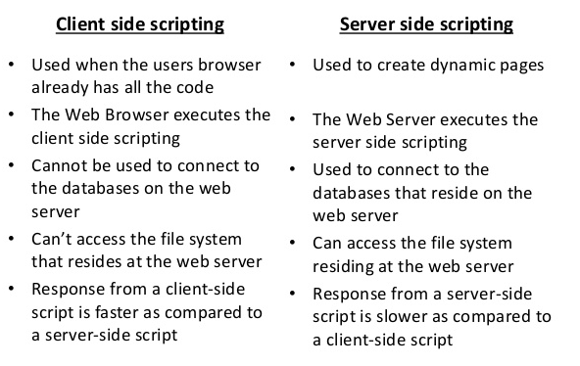

Slide 32
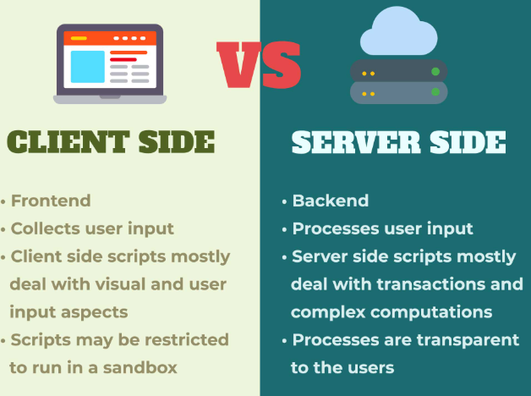

Slide 33
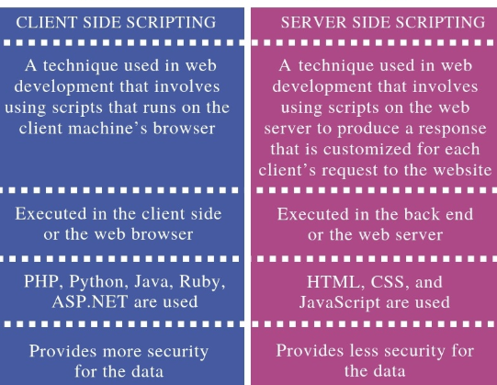

Slide 34
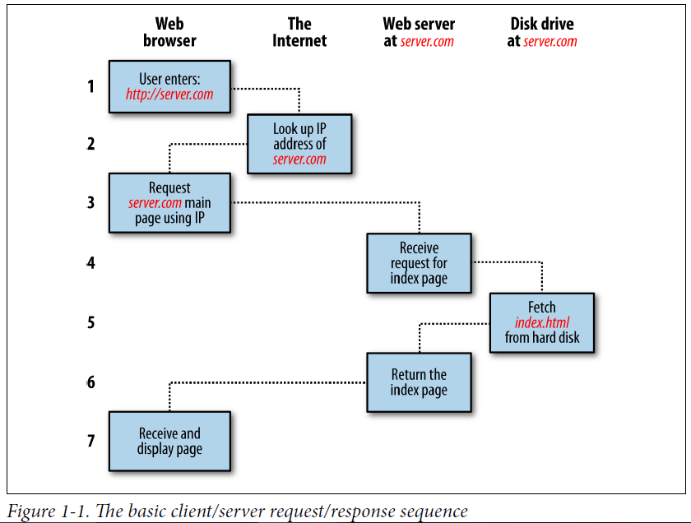

Slide 35
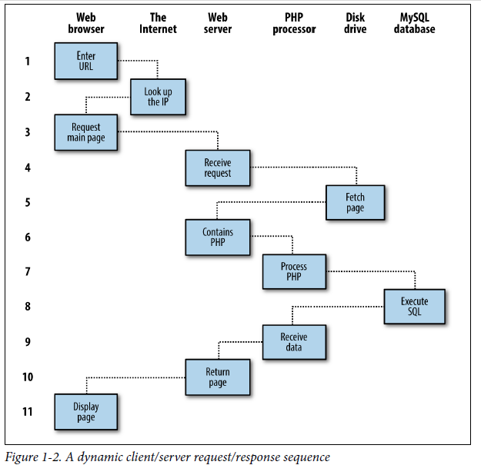

Slide 36
1. You enter http://server.com into your browser’s address bar.
2. Your browser looks up the IP address for server.com.
3. Your browser issues a request to that address for the web server’s home page.
4. The request crosses the Internet and arrives at the server.com web server.
5. The web server, having received the request, fetches the home page from its hard disk.
6. With the home page now in memory, the web server notices that it is a file incorporating PHP scripting and passes the page to the PHP interpreter.
7. The PHP interpreter executes the PHP code.
8. Some of the PHP contains MySQL statements, which the PHP interpreter now passes to the MySQL database engine.
9. The MySQL database returns the results of the statements to the PHP interpreter.
10. The PHP interpreter returns the results of the executed PHP code, along with the results from the MySQL database, to the web server.
11. The web server returns the page to the requesting client, which displays it.

Slide 37
PHP
PHP is a server-side scripting language designed specifically for the Web. Within an HTML page, you can embed PHP code that will be executed each time the page is visited.
Your PHP code is interpreted at the Web server and generates HTML or other output that the visitor will see” (“PHP and MySQL Web Development”, Luke Welling and Laura Thomson, SAMS)

Slide 38
How PHP generates HTML/JS Web pages
Working Principle of PHP
Client Browser
1
4
3
PHP module
Apache
2
1: Client from browser send HTTP request (with POST/GET variables)
2: Apache recognizes that a PHP script is requested and sends the request to PHP module
3: PHP interpreter executes PHP script, collects script output and sends it back
4: Apache replies to client using the PHP script output as HTML output

Slide 39
PHP is a server side scripting language embedded in XHTML. It is an alternative to CGI, ASP, JSP
The PHP processor(module) works in two modes.
If the PHP processor finds XHTML tags in the PHP script then the code is simply copied to the output file.
When the processor finds the PHP code in the script then that code is interpreted and the output is copied to the output file
If you click for view the source on the web browser, you can never see the PHP script because the output of the PHP script is send directly to the browser but you can see the XHTML tags.

Slide 40
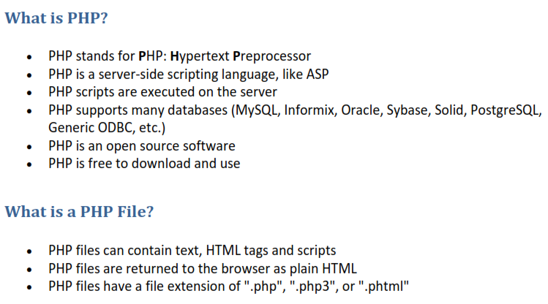
PHP

Slide 41
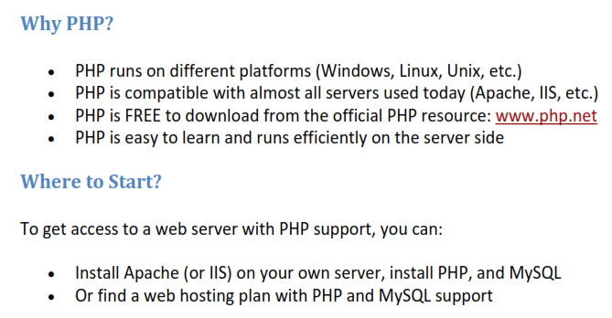

Slide 42
PHP Syntax
PHP (recursive acronym for PHP: Hypertext Preprocessor) is a widely-used open source general-purpose scripting language that is especially suited for web development and can be embedded into HTML.
A PHP script is executed on the server, and the plain HTML result is sent back to the browser.
Basic PHP Syntax
A PHP script can be placed anywhere in the document.A PHP script starts with <?php and ends with ?>:
<?php // PHP code goes here ?>
The default file extension for PHP files is ".php".
A PHP file normally contains HTML tags, and some PHP scripting code.
Example:
<?php
echo "Hello world";
?>

Slide 43
The Structure of PHP
Using Comments
There are two ways in which you can add comments to your PHP code.
1. The first turns a single line into a comment by preceding it with a pair of forward slashes:
// This is a comment
Example:
// echo "X equals $x";
You can also use this type of comment directly after a line of code to describe its
action, like this:
$x += 10; // Increment $x by 10
2. When you need multiple-line comments, there’s a second type of comment, which
looks like Example:
<?php
/* This is a section
of multiline comments
which will not be
interpreted */
?>
You can use the /* and */ pairs of characters to open and close comments almost
anywhere you like inside your code.

Slide 44
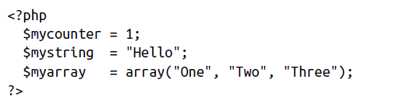
Basic Syntax
Semicolons
The PHP commands ended with a semicolon, like this:
$x += 10;
The $ symbol
All variables in PHP start with a $ symbol.
Whether your variables are numbers, strings, or arrays, they should all look something like those in Example

Slide 45
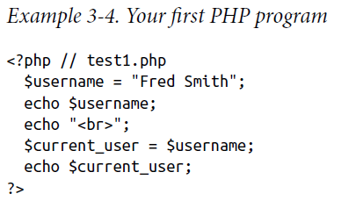
Variables
Variables are "containers" for storing information.
Variables are used to store values like, text strings, numbers, and arrays
String variables:
$username = "Fred Smith";
The quotation marks indicate that “Fred Smith” is a string of characters. You must enclose each string in either quotation marks or apostrophes (single quotes)
When you want to see what’s in the varibale, you can able to read it by using
echo $username;
Or you can assign it to another variable like this:
$current_user = $username;
Now you can call it up by entering the following into your browser’s address bar:
http://localhost/test1.php
The result of running this code should be two occurrences of the name Fred Smith,the first of which is the result of the echo $username command, and the second of the echo $current_user command.

Slide 46
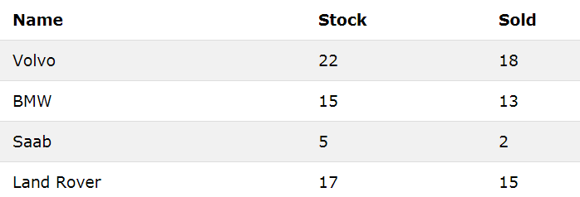
Numeric variables
$count = 17;
$count = 17.5;
Arrays
An array stores multiple values in one single variable:
$team = array('Bill', 'Mary', 'Mike', 'Chris', 'Anne');
Each string is enclosed in apostrophes.
If we then wanted to know who player 4 is, we could use this command:
echo $team[3]; // Displays the name Chris
Two-dimensional arrays
A multidimensional array is an array containing one or more arrays.
$cars = array ( array("Volvo",22,18), array("BMW",15,13), array("Saab",5,2), array("Land Rover",17,15) );

Slide 47
Variable-naming rules
Variable names must start with a letter of the alphabet or the _ (underscore) character.
• Variable names can contain only the characters a-z, A-Z, 0-9, and _ (underscore).
• Variable names may not contain spaces. If a variable must comprise more than one word, it should be separated with the _ (underscore) character
(e.g., $user_name).
• Variable names are case-sensitive. The variable $High_Score is not the same as the variable $high_score.
Operators
Operators are the mathematical, string, comparison, and logical commands such as
plus, minus, multiply, and divide. PHP looks a lot like plain arithmetic; for instance,
the following statement outputs 8:
echo 6 + 2;

Slide 48
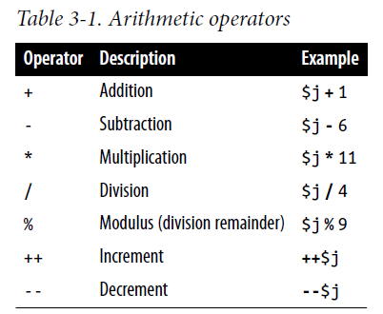
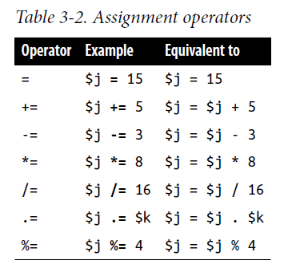
Arithmetic operators
They are used to perform mathematics. You can use them for the main four operations (plus, minus, times, and divide) as well as to find a modulus (the remainder after a division) and to increment or decrement a value (see Table 3-1).
Assignment operators
These operators are used to assign values to variables.
They start with the very simple
= and move on to +=, -=, and so on (see Table 3-2).
The operator += adds the value on
the right side to the variable on the left, instead of totally replacing the value on the
left. Thus, if $count starts with the value 5, the statement
$count += 1;
sets $count to 6, just like the more familiar assignment statement:
$count = $count + 1;
Strings have their own operator, the period (.), detailed in the section “String concatenation”

Slide 49
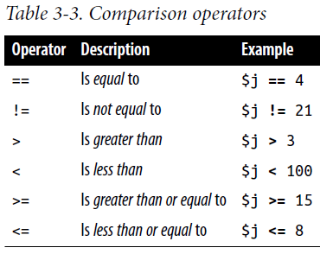
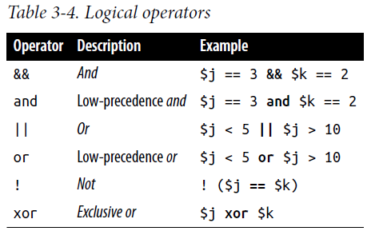
Comparison operators
Comparison operators are generally used inside a construct such as an if statement in which you need to compare two items.
For example, you may wish to know whether a variable you have been incrementing has reached a specific value, or whether another variable is less than a set value, and so on (see Table 3-3).
Logical operators
The PHP logical operators are used to combine conditional statements.

Slide 50
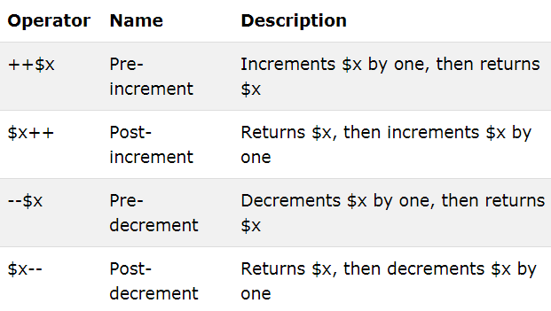
PHP Increment / Decrement Operators
The PHP increment operators are used to increment a variable's value.
The PHP decrement operators are used to decrement a variable's value.

Slide 51
Variable Assignment
The syntax to assign a value to a variable is always variable = value. Or, to reassign the value to another variable, it is other variable = variable.
$x += 10;
which tells the PHP parser to add the value on the right to the variable $x. Likewise, we could subtract as follows:
$y -= 10;
which tells the PHP parser to subtract the value on the right to the variable $y.
String concatenation
String concatenation uses the period (.) to append one string of characters to another.
echo "You have " . $msgs . " messages.";
Assuming that the variable $msgs is set to the value 5, the output from this line of
code will be the following:
You have 5 messages.
Just as you can add a value to a numeric variable with the += operator, you can
append one string to another using .=, like this:
$first_name.= $last_name;

Slide 52
String types
PHP supports two types of strings that are denoted by the type of quotation mark that you
use.
If you wish to assign a literal string, preserving the exact contents, you
should use the single quotation mark (apostrophe), like this:
$info = 'Preface variables with a $ like this: $variable';
If you had used double quotes, PHP would have attempted to evaluate $variable as a
variable.
On the other hand, when you want to include the value of a variable inside a string,
you do so by using double-quoted strings:
echo "This week $count people have viewed your profile";
Escaping characters
Sometimes a string needs to contain characters with special meanings that might be
interpreted incorrectly.
$text = 'My spelling's atroshus'; // Erroneous syntax
To correct this, you can add a backslash directly before the offending quotation mark to tell PHP to treat the character literally and not to interpret it:
$text = 'My spelling\'s still atroshus';
For example, the following double-quoted string will be correctly assigned:
$text = "She wrote upon it, \"Return to sender\".";

Slide 53
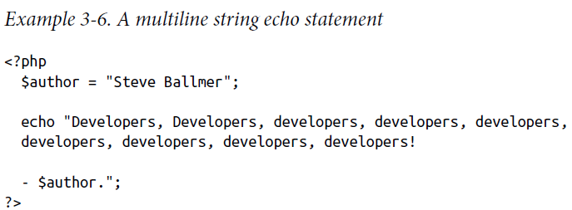
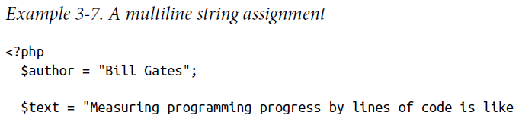
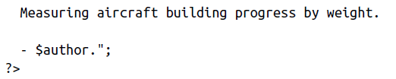
Additionally, you can use escape characters to insert various special characters into
strings such as tabs, newlines, and carriage returns. These are represented, as you
might guess, by \t, \n, and \r.
$heading = "Date\tName\tPayment";
Multiple-Line Commands
There are times when you need to output quite a lot of text from PHP, and using several echo (or print) statements would be time-consuming and messy. To overcome
this, PHP offers two conveniences. The first is just to put multiple lines between
quotes as in Example 3.6. Variables can also be assigned, as in Example 3-7.

Slide 54
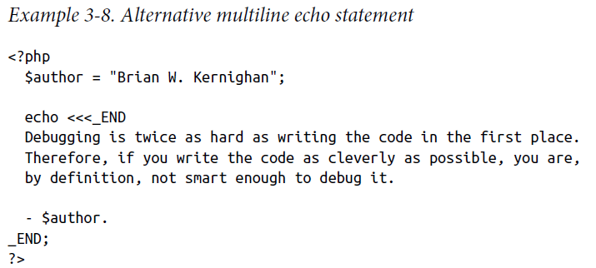
PHP also offers a multiline sequence using the <<< operator—commonly referred to
as a here-document or heredoc—as a way of specifying a string literal, preserving the
line breaks and other whitespace (including indentation) in the text. Its use can be
seen in Example 3-8.
This code tells PHP to output everything between the two _END tags as if it were a double-quoted string.
It is important to remember that the closing _END; tag must appear right at the start of a new line and it must be the only thing on that line—not even a comment is
allowed to be added after it (nor even a single space).
Once you have closed a multiline block, you are free to use the same tag name again.

Slide 55
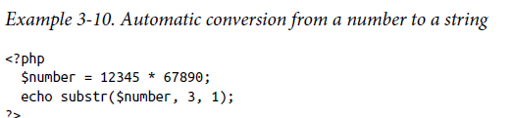
Variable Typing
PHP is a very loosely typed language. This means that variables do not have to be declared before they are used, and that PHP always converts variables to the type required by their context when they are accessed.
For example, you can create a multiple-digit number and extract the nth digit from it simply by assuming it to be a string.
In the following snippet of code, the numbers12345 and 67890 are multiplied together, returning a result of 838102050, which is then placed in the variable $number, as shown in Example 3-10.
To do this, PHP turns $number into a nine-character string, so that
substr can access it and return the character, which in this case is 1.

Slide 56
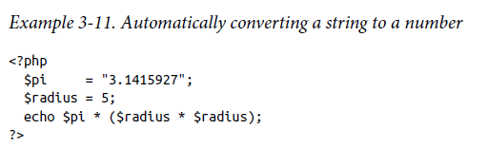
The same goes for turning a string into a number, and so on. In Example 3-11, the variable $pi is set to a string value, which is then automatically turned into a floating point number in the third line by the equation for calculating a circle’s area, which outputs the value 78.5398175.
Constants
Constants are similar to variables, holding information to be accessed later. In other words, once you have defined one, its value is set for the remainder of the program and cannot be altered.
One example of a use for a constant is to hold the location of your server root (the
folder with the main files of your website). You would define such a constant like this:
define("ROOT_LOCATION", "/usr/local/www/");
Then, to read the contents of the variable, you just refer to it like a regular variable
$directory = ROOT_LOCATION;

Slide 57
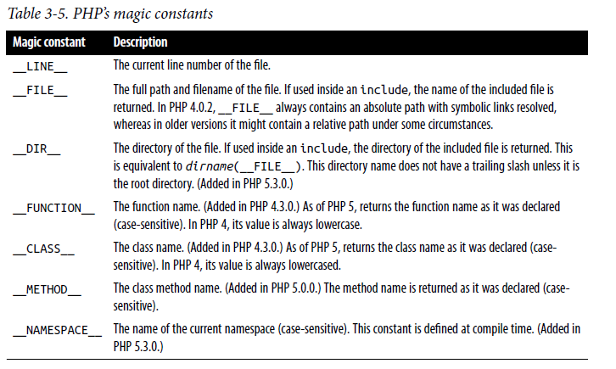
Predefined Constants
PHP comes ready-made with dozens of predefined constants. there are a few—known as the magic constants—always have two underscores at the beginning and two at the end.

Slide 58
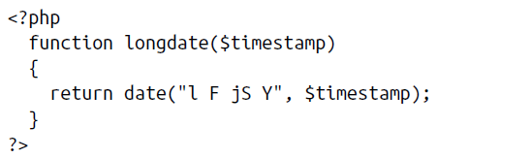
Functions
Functions are used to separate out sections of code that perform a particular task.
Functions can be passed parameters to make them perform differently.
They can also return values to the calling code.
Any number of parameters can be passed between the initial parentheses.
The curly braces enclose all the code that is executed when you later call the function.
This function takes a Unix timestamp (an integer number representing a date and time based on the number of seconds since 00:00 a.m. on January 1, 1970) as its input and then calls the PHP date function with the correct format string to return a date in the format Tuesday May 2nd 2017.

Slide 59
To output today’s date using this function, place the following call in your code:
echo longdate(time());
This call uses the built-in PHP time function to fetch the current Unix timestamp and passes it to the new longdate function, which then returns the appropriate string to the echo command for display.
If you need to print out the date 17 days ago, you now just have to issue the following call:
echo longdate(time() - 17 * 24 * 60 * 60);
which passes to longdate the current Unix timestamp less the number of seconds since 17 days ago (17 days × 24 hours × 60 minutes × 60 seconds).
Functions can also accept multiple parameters and return multiple results

Slide 60
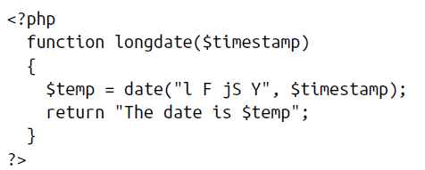
Variable Scope
A scope is a region of the program and the scope of the variable referes to the area
of the program where the variables can be accessed and after its declaration.
Local variables
Local variables are variables that are created within, and can be accessed only by, a function.
They are generally temporary variables that are used to store partially processed results prior to the function’s return.
You can’t get or set its value outside the function.
For another example of a local variable, take another look at the longdate function
Here we have assigned the value returned by the date function to the temporary variable $temp, which is then inserted into the string returned by the function.
As soon as the function returns, the value of $temp is cleared, as if it had never been used at all.

Slide 61
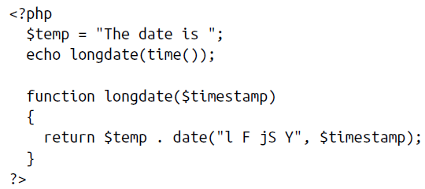
Here $temp has been created before we call the longdate function.
Global variables
To declare a variable as having global scope, use the keyword global.
Example: global $is_logged_in;
You can able to access this global variable from any function, without the scope.
It is visible (hence accessible) throughout the program.
Static variables
A static variable will not lose its value when the function exits and will still hold that value should the function be called again.

Slide 62
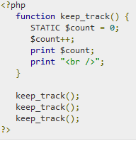
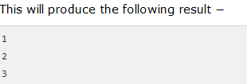
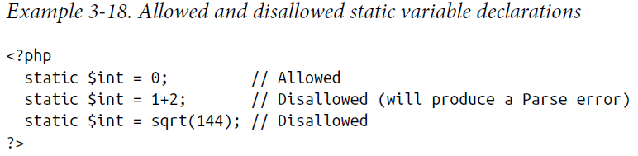
They can be initialized only with predetermined values

Slide 63
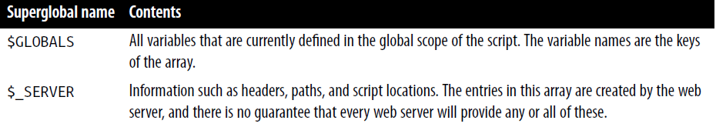
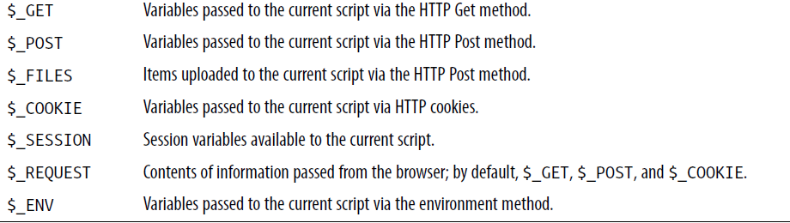
Superglobal variables
Starting with PHP 4.1.0, several predefined variables are available. These are known
as superglobal variables, which means that they are provided by the PHP environment
but are global within the program, accessible absolutely everywhere.
All of the superglobals (except for $GLOBALS) are named with a single initial underscore and only capital letters
They are mainly used to store and get information from one page to another etc in an application.

Slide 64
PHP and MYSQL Interaction

Slide 65


Slide 66


Slide 67


Slide 68


Slide 69


Slide 70


Slide 71


Slide 72


Slide 73
JavaScript framework
A JavaScript framework is a collection of JavaScript code libraries that provide a web developer with pre-written code for routine programming tasks.
Frameworks are structures with a particular context and help you create web applications within that context.
Frameworks provide a template that handles common programming patterns.
Each time we build an application, need not to write code for every single feature from scratch. Instead, we can build upon an existing feature set.
FRAMEWORK VS. LIBRARY
A JS framework is a full toolset that helps shape and organize your website or application.
A JS library, on the other hand, is a collection of pre-written code snippets that are less about shaping your application and more about providing a use-as-needed library of features.

Slide 74
POPULAR JAVASCRIPT FRAMEWORKS
FRONT-END FRAMEWORKS
REACT
ANGULAR
VUE
BACK-END FRAMEWORKS
EXPRESS
NEXT.JS

Slide 75


Web 2.0 Technologies

Slide 76
Useful Web 2.0 Tools
Weblogs
Wikis
Real Simple Syndication (RSS)
Aggregators
Social Bookmarking and Networking
Online Photo Galleries
Audio/video-casting
*Not the only web 2.0 tools! Keep educational uses in mind when looking at these.
Notes:
Quick list of some tools. (explain on following slides)

Slide 77
Weblogs (Blogs)
Easily created/updated sites.
Publish instantly from any internet connection.
Interactive - comment, question, link, converse.
Notes:
Discuss experience with blogs with students. Talk about different uses: journaling, news reporting, personal diaries, communicating in education about peers, with parents and students. Includes multi-media and gadgets or widgets.

Slide 78

Wikis
Collaborative page.
Anyone can add or edit content.
Wikipedia - friend or foe?
Wikispaces
Notes:
Most famous is Wikipedia. Wiki means “quick” in Hawaiian. Losing popularity.

Slide 79
Real Simple Syndication
Subscribe to “feeds” from your favorite sites.
New information is sent to you.
Reduces research time.
Notes:
Think about syndicating like Peanuts cartoon, it comes to you, you don’t have to go to find it. Many sites have a RSS button.

Slide 80

Aggregators
Collects and organizes the content you subscribe to with an RSS feed.
Notes:
Great for collecting your “stuff” on the Internet, such as email, RSS, new feeds, following blogs and all your favorite sites.

Slide 81


Social Bookmarking
Save web addresses of useful content.
Share and search bookmarks.
Generate specific resource lists.
Notes:
Early option was delicious.com for saving useful URLs. Many more tools now can do much the same thing.

Slide 82

Social Networking
Facebook, Twitter
LinkedIn.com
Collaborate, bookmark, share, etc.
Notes:
Top names now are Facebook and Twitter. Formerly was MySpace. Discuss the use of Facebook in education, in class, the affect on socializing and relationships.

Slide 83

Online Photo Galleries
Publish photos online.
Comment, and share ideas.
Create photo stories and presentations.

Slide 84

Audio/video-casting
Produce audio and video recordings.
Publish them easily to the web.
Creates a world-wide audience.

Slide 85


Other Fun Web 2.0 Sites

Slide 86

Time to Explore
Visit www.bighugelabs.com
In groups of three choose one of the tools and prepare a short explanation of what it can do.

Slide 87

Are you ready for this?
Visit www.go2web20.net
In groups of three choose a web 2.0 tool to share with the class.

Slide 88
Time to bring it all together
How could these tools be used in a particular grade level and content area?
What do these tools bring to a lesson that is unique?
What are some disadvantages or risks associated with these tools?
What are some of the benefits and challenges of utilizing web 2.0 tools?

Slide 89
Overview of JavaScript frameworks-Ajax

Slide 90

Synchronous web communication
synchronous: user must wait while new pages load
the typical communication pattern used in web pages (click, wait, refresh)

Slide 91
Web applications and Ajax
web application: a dynamic web site that mimics the feel of a desktop app
presents a continuous user experience rather than disjoint pages
examples: Gmail, Google Maps, Google Docs and Spreadsheets, Flickr, A9

Slide 92

Web applications and Ajax
Ajax: Asynchronous JavaScript and XML
not a programming language; a particular way of using JavaScript
downloads data from a server in the background
allows dynamically updating a page without making the user wait
avoids the "click-wait-refresh" pattern
Example: Google Suggest

Slide 93

Asynchronous web communication
asynchronous: user can keep interacting with page while data loads
communication pattern made possible by Ajax

Slide 94
XMLHttpRequest (and why we won't use it)
JavaScript includes an XMLHttpRequest object that can fetch files from a web server
supported in IE5+, Safari, Firefox, Opera, Chrome, etc. (with minor compatibilities)
it can do this asynchronously (in the background, transparent to user)
the contents of the fetched file can be put into current web page using the DOM

Slide 95
XMLHttpRequest (and why we won't use it)
sounds great!...
... but it is clunky to use, and has various browser incompatibilities
Prototype provides a better wrapper for Ajax, so we will use that instead

Slide 96
A typical Ajax request
user clicks, invoking an event handler
handler's code creates an XMLHttpRequest object
XMLHttpRequest object requests page from server
server retrieves appropriate data, sends it back
XMLHttpRequest fires an event when data arrives
this is often called a callback
you can attach a handler function to this event
your callback event handler processes the data and displays it

Slide 97

A typical Ajax request

Slide 98
Prototype's Ajax model
new Ajax.Request("url",
{
option : value,
option : value,
...
option : value
}
); JS
construct a Prototype Ajax.Request object to request a page from a server using Ajax
constructor accepts 2 parameters:
the URL to 1. fetch, as a String,
a set of options, as an array of key : value pairs in {} braces (an anonymous JS object)
Notes:
2.
hides icky details from the raw XMLHttpRequest; works well in all browsers

Slide 99
Prototype Ajax methods and properties
option | description
method | how to fetch the request from the server (default "post")
parameters | query parameters to pass to the server, if any
asynchronous (default true), contentType, encoding, requestHeaders
options that can be passed to the Ajax.Request constructor

Slide 100
Prototype Ajax methods and properties
event | description
onSuccess | request completed successfully
onFailure | request was unsuccessful
onException | request has a syntax error, security error, etc.
events in the Ajax.Request object that you can handle

Slide 101
Basic Prototype Ajax template
property | description
status | the request's HTTP error code (200 = OK, etc.)
statusText | HTTP error code text
responseText | the entire text of the fetched page, as a String
responseXML | the entire contents of the fetched page, as an XML DOM tree (seen later)
function handleRequest(ajax) {
alert(ajax.responseText);
} JS

Slide 102

XMLHttpRequest security restrictions
cannot be run from a web page stored on your hard drive
can only be run on a web page stored on a web server
can only fetch files from the same site that the page is on www.foo.com/a/b/c.html can only fetch from www.foo.com

Slide 103
Handling Ajax errors
new Ajax.Request("url",
{
method: "get",
onSuccess: functionName,
onFailure: ajaxFailure,
onException: ajaxFailure
}
);
...
function ajaxFailure(ajax, exception) {
alert("Error making Ajax request:" + "\n\nServer status:\n" + ajax.status + " " + ajax.statusText +
"\n\nServer response text:\n" + ajax.responseText);
if (exception) {
throw exception;
}
} JS
for user's (and developer's) benefit, show an error message if a request fails
Notes:
for user's (and developer's) benefit, show an error message if a request fails

Slide 104

Debugging Ajax code
Net tab shows each request, its parameters, response, any errors
expand a request with + and look at Response tab to see Ajax result

Slide 105
Creating a POST request
new Ajax.Request("url",
{
method: "post", // optional
parameters: { name: value, name: value, ..., name: value },
onSuccess: functionName,
onFailure: functionName,
onException: functionName
}
); JS
Notes:
http://www.tizag.com/ajaxTutorial/index.php

Slide 106
Creating a POST request
Ajax.Request can also be used to post data to a web server
method should be changed to "post" (or omitted; post is default)
any query parameters should be passed as a parameters parameter
written between {} braces as a set of name : value pairs (another anonymous object)
get request parameters can also be passed this way, if you like

Slide 107
Prototype's Ajax Updater
new Ajax.Updater(
"id",
"url",
{
method: "get"
}
); JS
Ajax.Updater fetches a file and injects its content into an element as innerHTML
additional (1st) parameter specifies the id of element to inject into

Slide 108


Slide 109


Slide 110


Slide 111
Simple AJAX Example
Enter username
If you have been to the site before
Say welcome back
Else
Say nice to meet you
Enter into list (perhaps)
ajaxform.html, ajax.js, ajax.php
http://dna.cs.byu.edu/~snell/Classes/CS360/simpleajax/ajaxform.html

Slide 112
// Download the data in data.xml and load it on the map. The format we expect is:
// <markers>
// <marker lat="37.441" lng="-122.141" note="marker notes"/>
// <marker lat="37.322" lng="-121.213" note="marker notes"/>
// </markers>
// <trail>
// <point lat="37.441" lng="-122.141"/>
// <point lat="37.322" lng="-121.213"/>
// </trail>

Slide 113
function loadMap(filename)
{
var request = GXmlHttp.create();
request.open("GET", filename, true);
request.onreadystatechange = function()
{
if (request.readyState == 4)
{
var xmlDoc = request.responseXML;
var markers = xmlDoc.documentElement.getElementsByTagName("marker");
mapmarkers.length=0;
for (var i = 0; i < markers.length; i++)
{
mapmarkers.push(createMarker(new GLatLng(parseFloat(markers[i].getAttribute("lat")), parseFloat(markers[i].getAttribute("lng"))), markers[i].getAttribute("note")));
map.addOverlay(mapmarkers[i]);
}

Slide 114
map.setCenter(new GLatLng(parseFloat(markers[0].getAttribute("lat")), parseFloat(markers[0].getAttribute("lng"))), 13);
mappoints.length = 0;
var trailpoints = xmlDoc.documentElement.getElementsByTagName("point");
for (var i = 0; i < trailpoints.length; i++)
{
var tpoint = new GLatLng(parseFloat(trailpoints[i].getAttribute("lat")), parseFloat(trailpoints[i].getAttribute("lng")));
mappoints.push(tpoint);
}
map.addOverlay(new GPolyline(mappoints));
}
}
request.send(null);
}

Slide 115
Examples of Ajax Application
Given below are the lists of web applications that commonly use Ajax
Google suggests that auto-complete options will be offered while typing when a user enters the search query in the Google search bar. Suggestions given by Google can be navigated by using operational keys.

Slide 116
Yahoo maps are easier while operating, and user experiences more fun. This Map uses Ajax to drag the entire map with the mouse without using buttons that will be at ease to the user.
Google maps are general applications that use Ajax. This is a real-time application in which the user can manipulate the data and change the view settings. Ajax directly works on a web browser without any plugin installations. Firstly, only Microsoft internet explorer used Ajax, but due to its reliability, more web applications like chrome, Mozilla… Etc. using this.

Slide 117
THANK YOU

